Slide 1


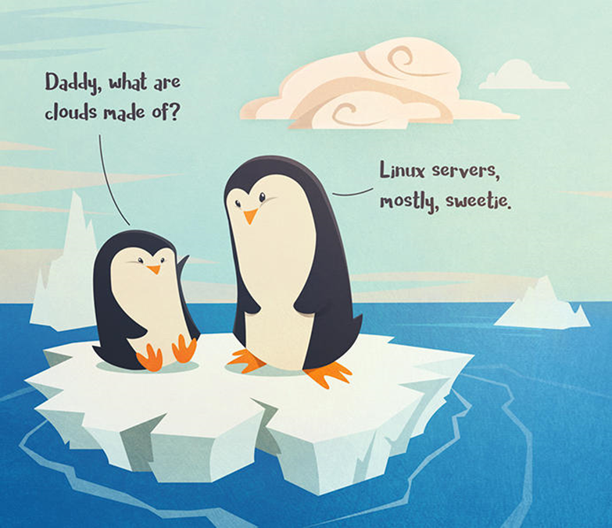
AKS and DevOPS
A journey of discovery and enlightenment

Slide 2
About me
Development experience on Microsoft platform starting with VB6 to .NET Core and everything in between
Embracing Linux, .NET core, docker, AKS wholesale in current project
Experience as Solution / Enterprise / Integration Architect in very large companies. HP, CIGNA, UNITED HEALTH, HESS, BP, COMCAST

Slide 3
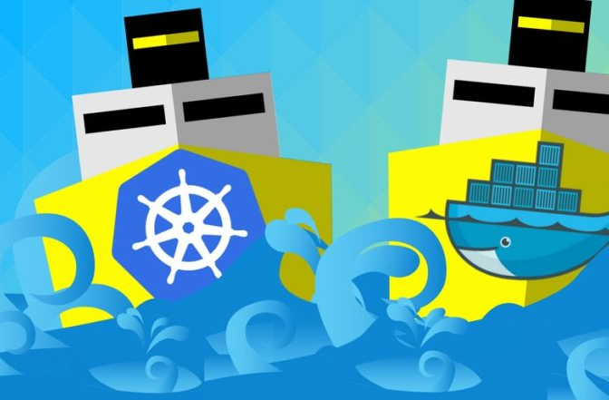
BASIC JARGON
CONTAINER
MICRO SERVICES
YAML, DOCKERFILE
DOCKER
KUBERNETES
REGISTRY
ORCHESTRATION

Slide 4
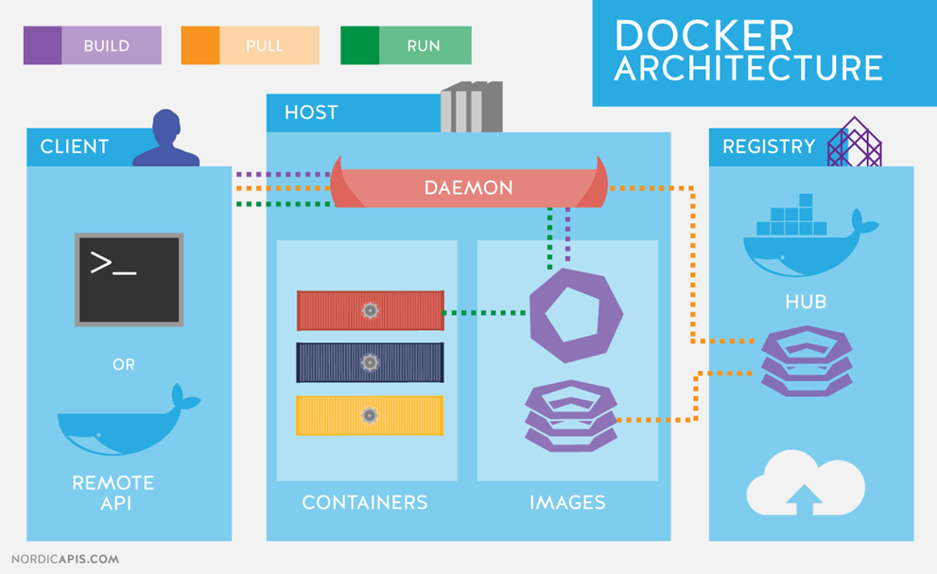
CONCEPTS - CONTAINERS
CONTAINER DEFINITION
CONTAINER IMAGE
CONTAINER REGISTRY
CONTAINER INSTANCE
CONTAINER ENGINE
CONTAINER ORCHESTRATOR

Slide 5
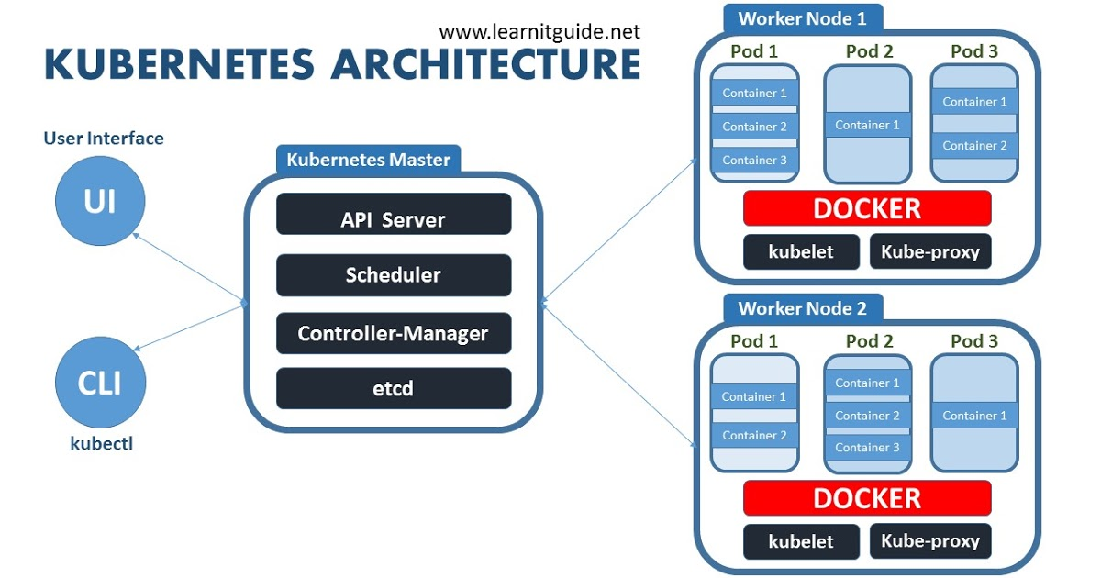
WHY DOCKER and KUBERNETES
Open Source / Cloud Agnostic
Tons of pre-built images available to build the platform environment
Multi-Tenancy with Isolation
Scalability, BC/DR
Zero downtime deployments Canary, Rolling Update, A/B etc.

Slide 6
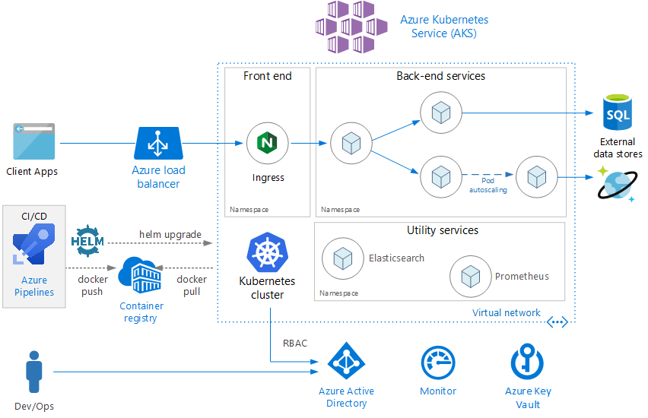
AKS on AZURE
Security
Monitoring
Dev/Ops
SQL / Cosmos
WASB
Key Vault
Active Directory
Dev Ops
Service Bus

Slide 7
CONCEPTS-KUBERNETES
DEPLOYMENTS
PODS
NAMESPACES
ENVIRONMENT VARIABLES
CONFIGMAP / SECRETS
SERVICE
INGRESS

Slide 8
TOOLS
CURL
DOCKER EDGE (DOCKER + KUBERNETES)
AZURE CLI (AZ and AZDS – Azure Dev Spaces)
CLOUD SHELL
HELM
VISUAL STUDIO
DRAFT
TERRAFORM

Slide 9
AZURE and DEVOPS RESOURCES
DEV.AZURE.COM (Azure Dev Ops or VisualStudio.com)
GIT Repository
Build and Release pipeline
AZURE CONTAINER REGISTRY
AKS
AZURE KEY VAULT
APPLICATION INSIGHTS
Dev Spaces
Azure Blob / File Storage (Gen 2 based on HDFS)
SQL Server 2019 Big Data cluster (BDC)

Slide 10
Lab
Install Docker Desktop
Install Azure CLI
Install Helm – Do this after creating and connecting your cluster with get-credentials https://github.com/helm/helm/releases
kubectl apply -f helm-rbac.yaml then download helm and run.\helm init --service-account tiller
Get a Azure trial subscription
Create an organization / repository on Dev.Azure.Com
Visual Studio if you have it otherwise any text editor is fine.
Powershell
https://aksworkshop.io/

Slide 11
HelpFUL links
https://docs.docker.com/get-started/part2/
https://aksworkshop.io/ - We will do this today
https://docs.microsoft.com/en-us/azure/aks/
https://azure.microsoft.com/en-us/resources/kubernetes-learning-path/
https://github.com/Azure/aad-pod-identity
https://github.com/Azure/kubernetes-keyvault-flexvol
https://blog.container-solutions.com/kubernetes-deployment-strategies
https://istio.io/docs/setup/kubernetes/getting-started/
https://www.learnitguide.net/2018/08/create-kubernetes-yaml-for-deployment.html
https://kubernetes.io/docs/reference/kubectl/cheatsheet/

